Slide 1


Wine Ratings – Which Wine is the Best?
Andrea Fox
Summer 2021
DSC680 – Applied Data Science

Slide 2

Table of Contents
Introduction
Variables
Clean-up
Visual Analysis
Technical Analysis
Wrap-up
Questions

Slide 3
Introduction
Dataset came from Kaggle – Wine Rating & Price (Budnyak, 2020)
Contained 4 different files
8 variables

Slide 4
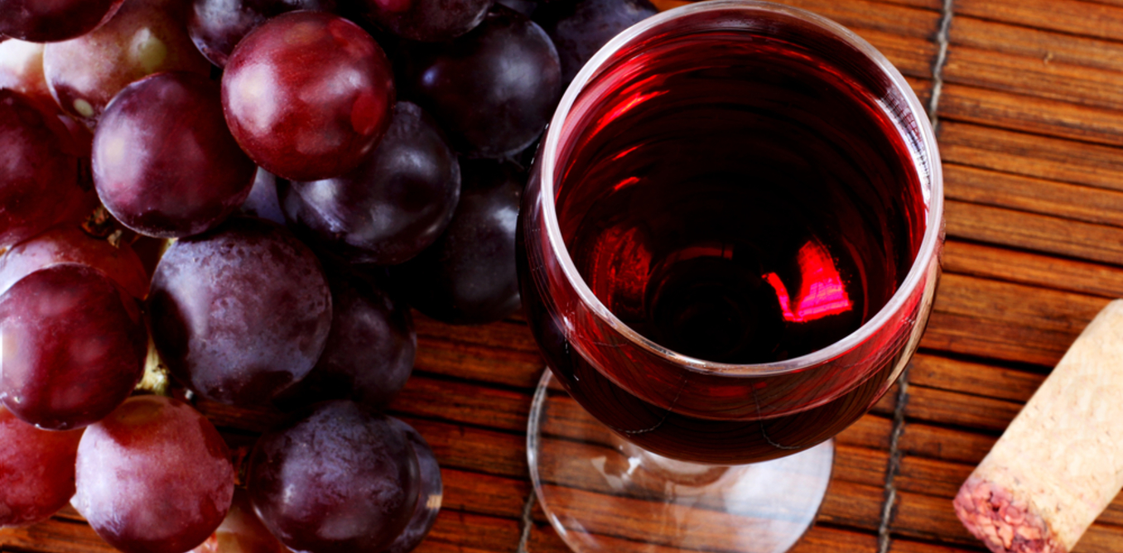
Variables
Name
Country
Region
Winery
Rating
Number of Ratings
Price
Year
This Photo by Unknown Author is licensed under CC BY-ND

Slide 5
Overview of Cleaning
Read in 4 files
Looked for null values
Describe()
Added new column of “Type”
Combined 4 files into 1
Change values of N.V.

Slide 6
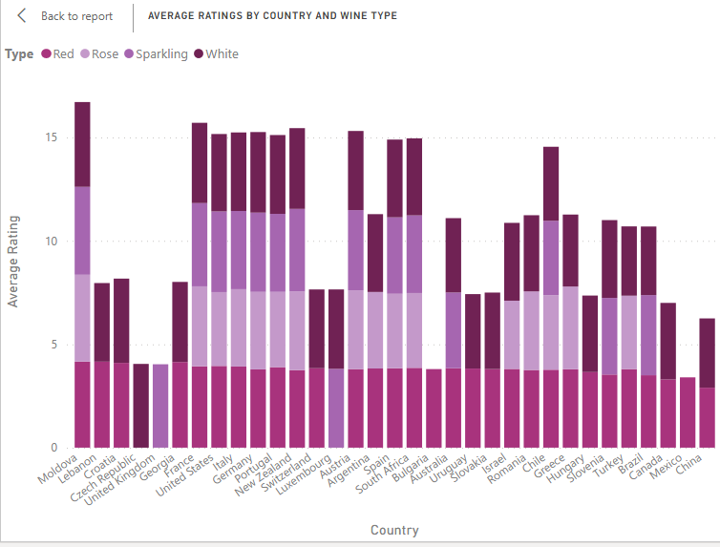
Visual Analysis
Used PowerBi to create
Three dashboards
Overview
Locations
Country Specifics

Slide 7
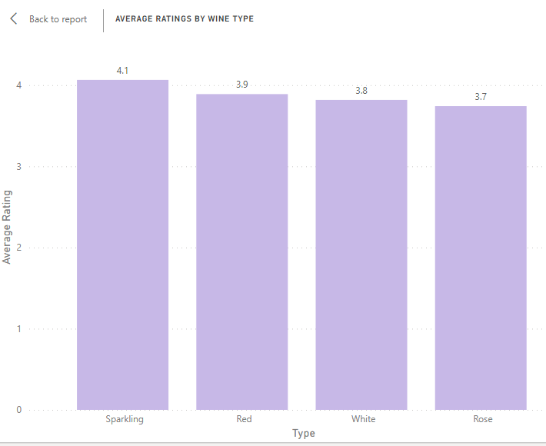
Overview Dashboard

Slide 8
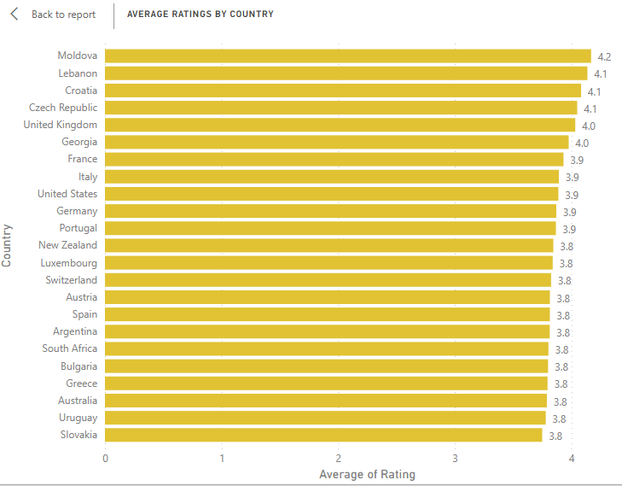
Locations Dashboard

Slide 9
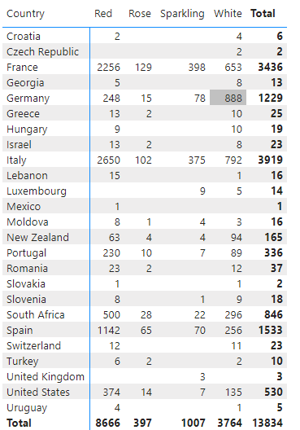
Country Specifics Dashboard

Slide 10
Technical Analysis
Read in new csv file
Removed column
Correlation
Ratings
Price

Slide 11
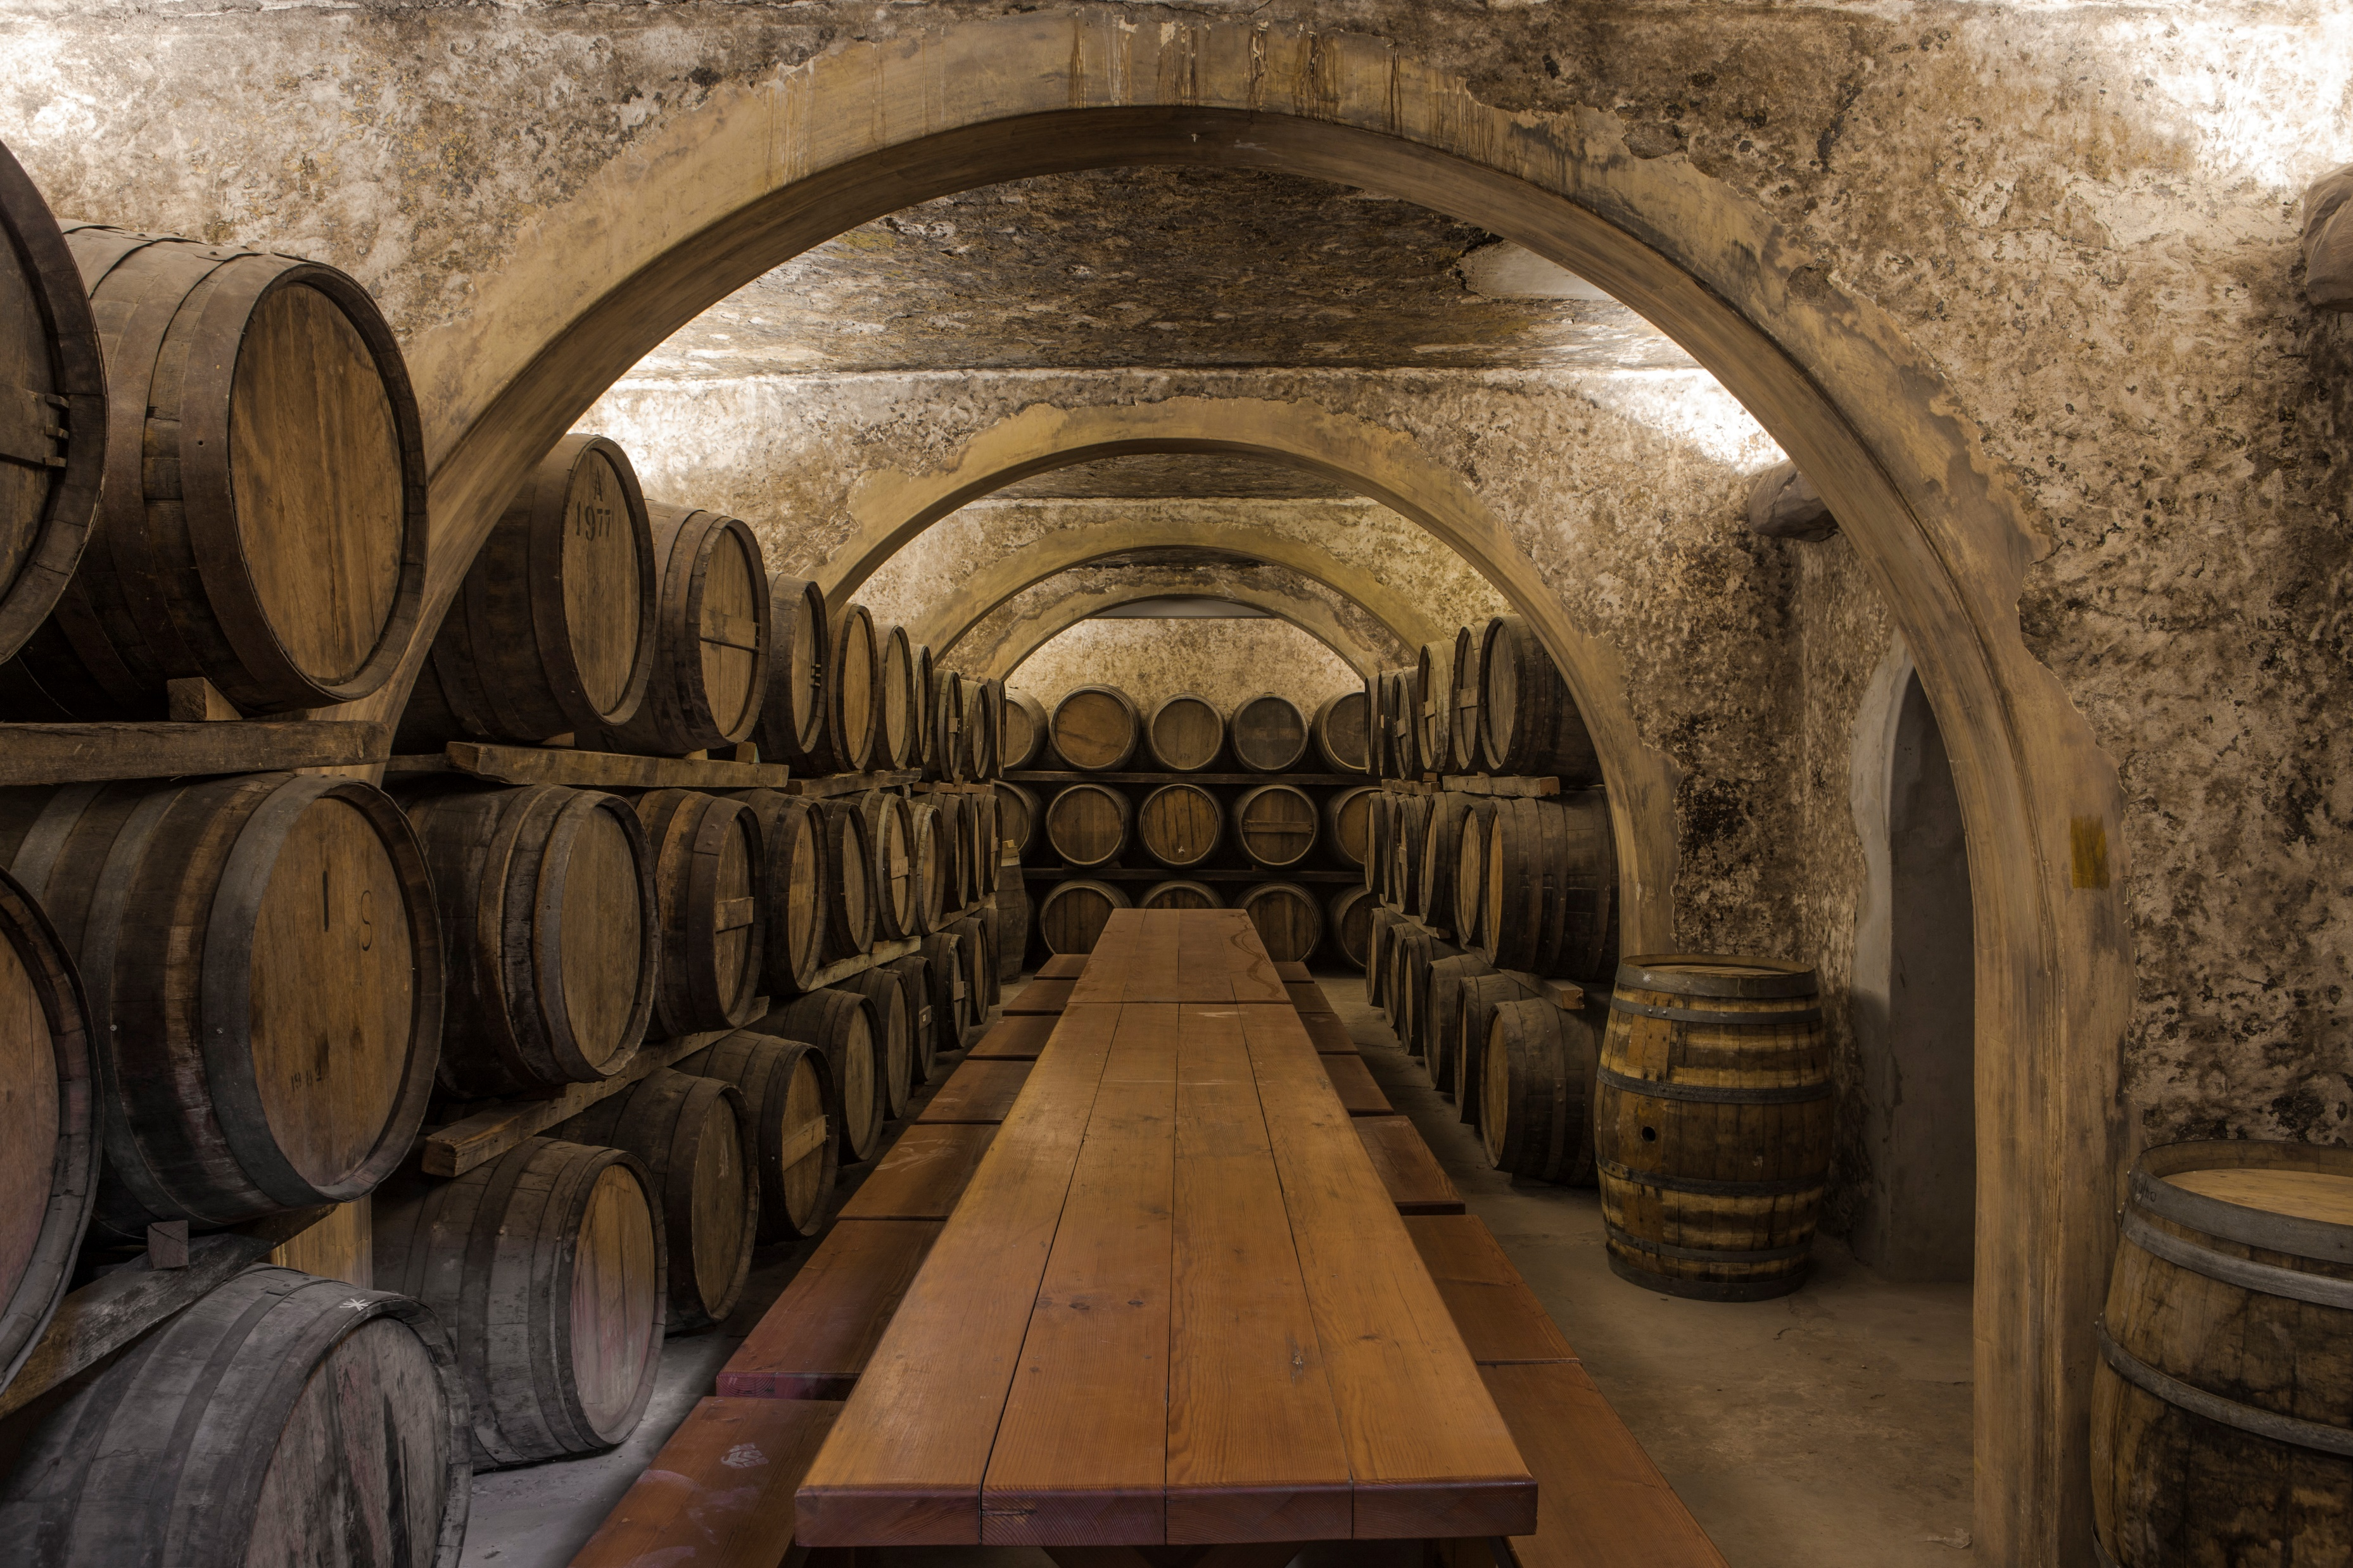
Wrap-up

Slide 12

Questions?
This Photo by Unknown Author is licensed under CC BY-SA-NC

Slide 13
Questions 1 - 5
Do you think the data will be skewed since some countries and regions had a small number of ratings versus others?
What criteria are you using to consider the best? Is it rating? Price? Combination?
Is it possible that events during the wine vintage year would influence the overall rating?
Do ratings by wine type differ by region? For example, if Napa Valley is known for producing more red wines would those ratings be higher?
Does a higher price equal a better wine?

Slide 14
Questions 6 - 10
Would it make more sense to find the best wine by type instead of overall?
Do you think flavor (sweet, dry) will influence wine ratings by type?
Price is done in Euros, is there a way to find out average price by US dollars?
What are the odds that you end up trying the wine that is overall best wine or best by types?
How has this project changed your perception of wine?

Slide 15
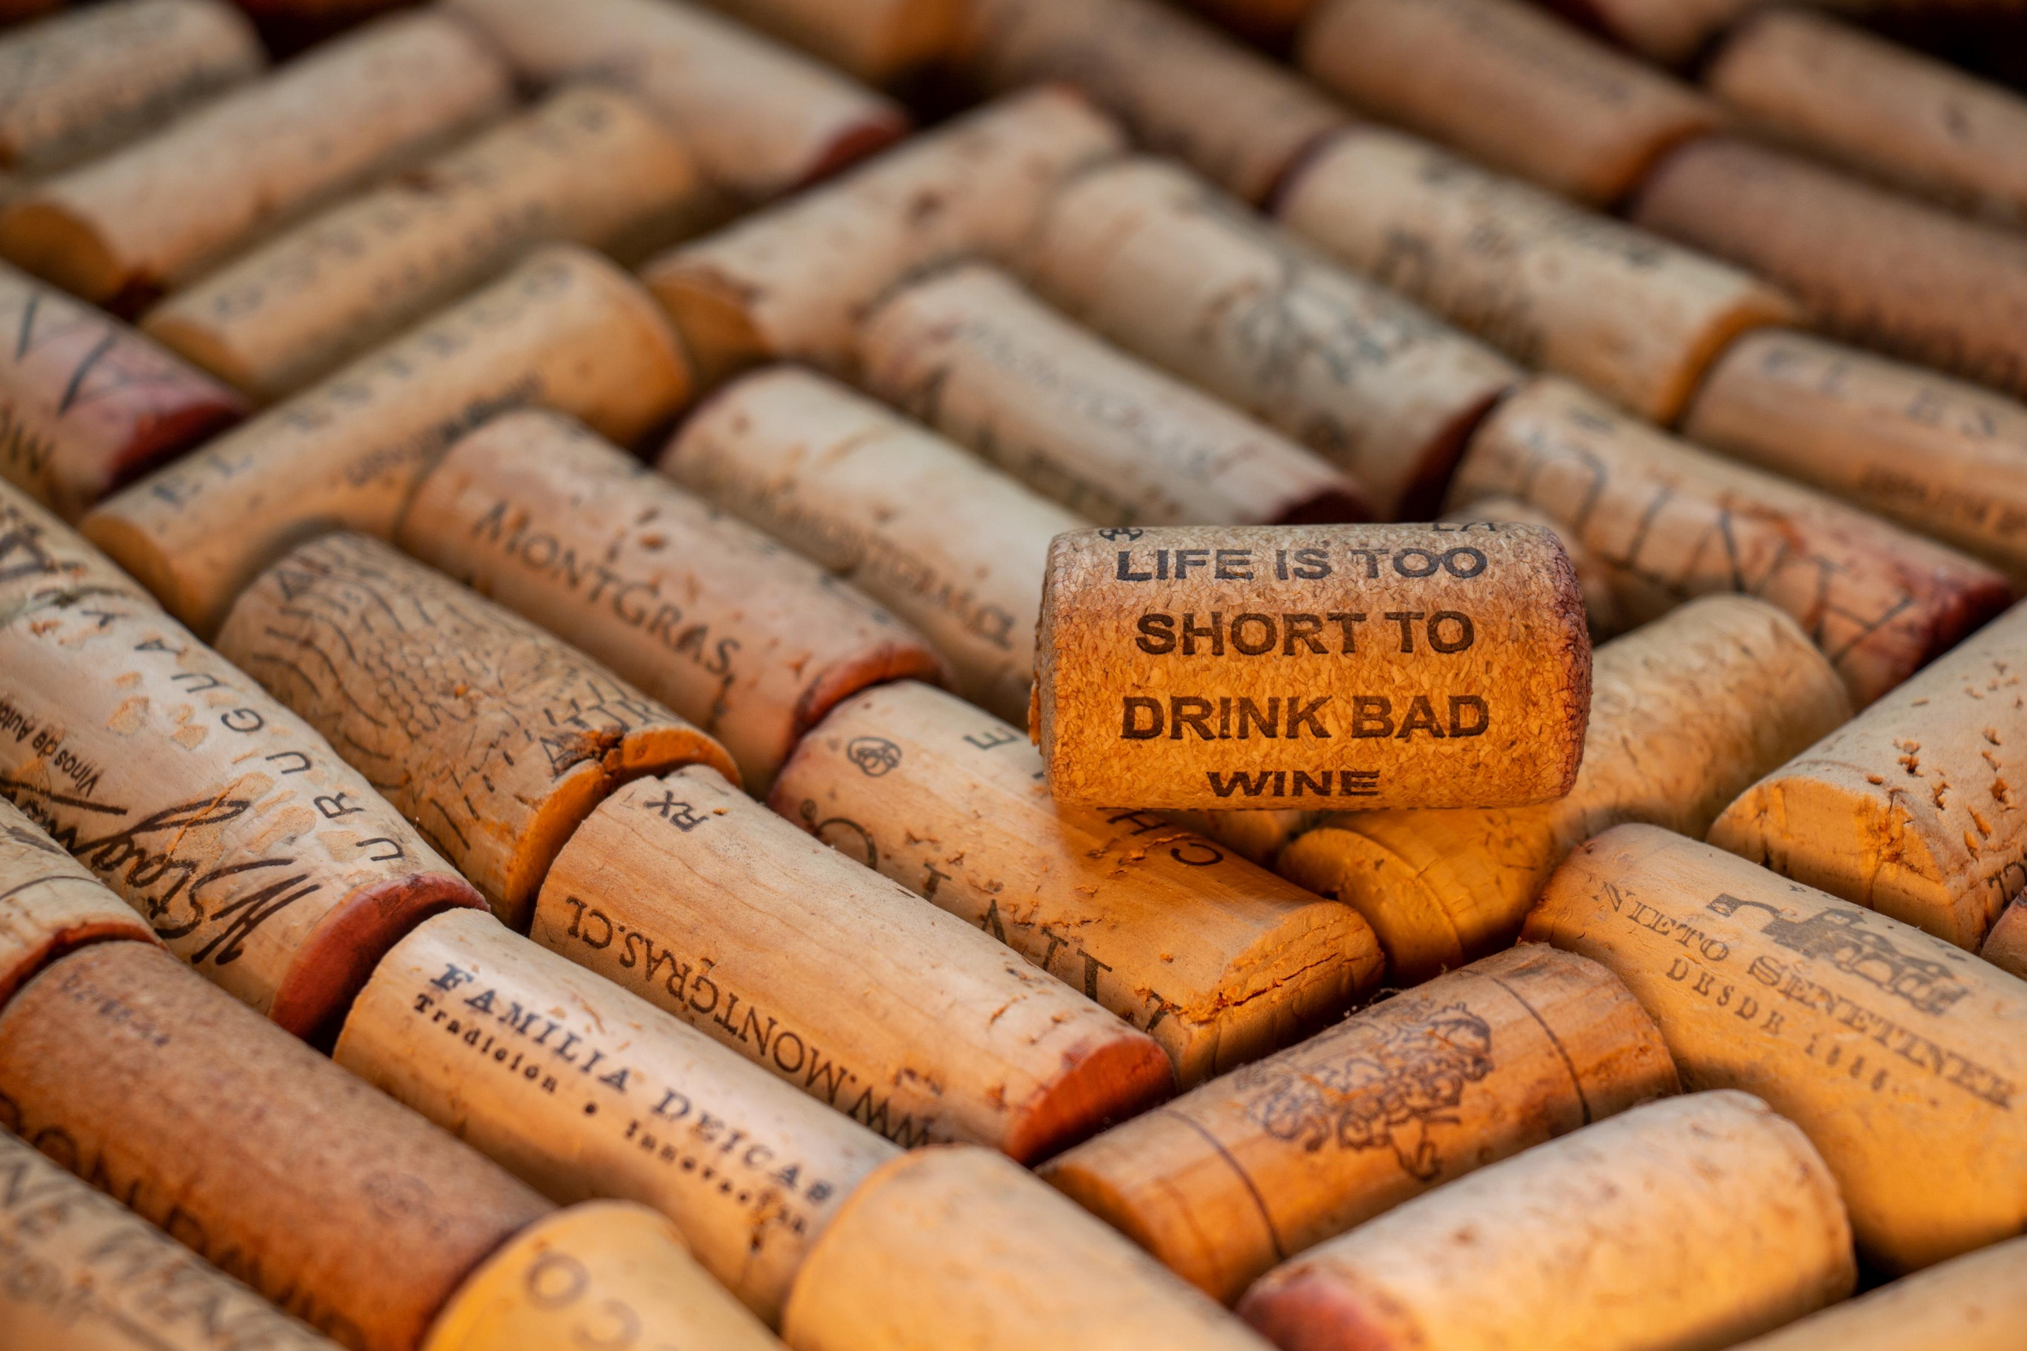
Thank you!

Slide 16
References
Title page image credit - photo nic on Unsplash
Table of Contents image credit - Carson Masterson on Unsplash
Budnyak, Anton. (2020, August 27). Wine Rating & Price. Retrieved from Kaggle: https://www.kaggle.com/budnyak/wine-rating-and-price
Thank you slide image credit - D A V I D S O N L U N A on Unsplash

